Slide 1
Schools on Board
Evaluation Plan
Summer Institute for Program Evaluation
June 3-7, 2013

Slide 3
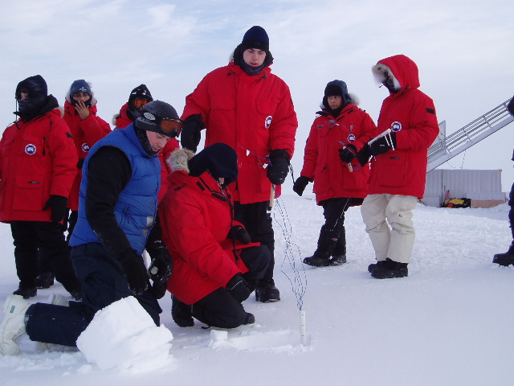
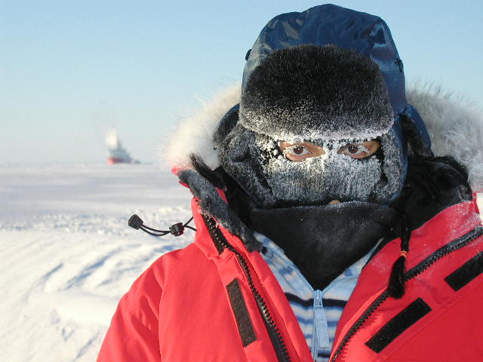
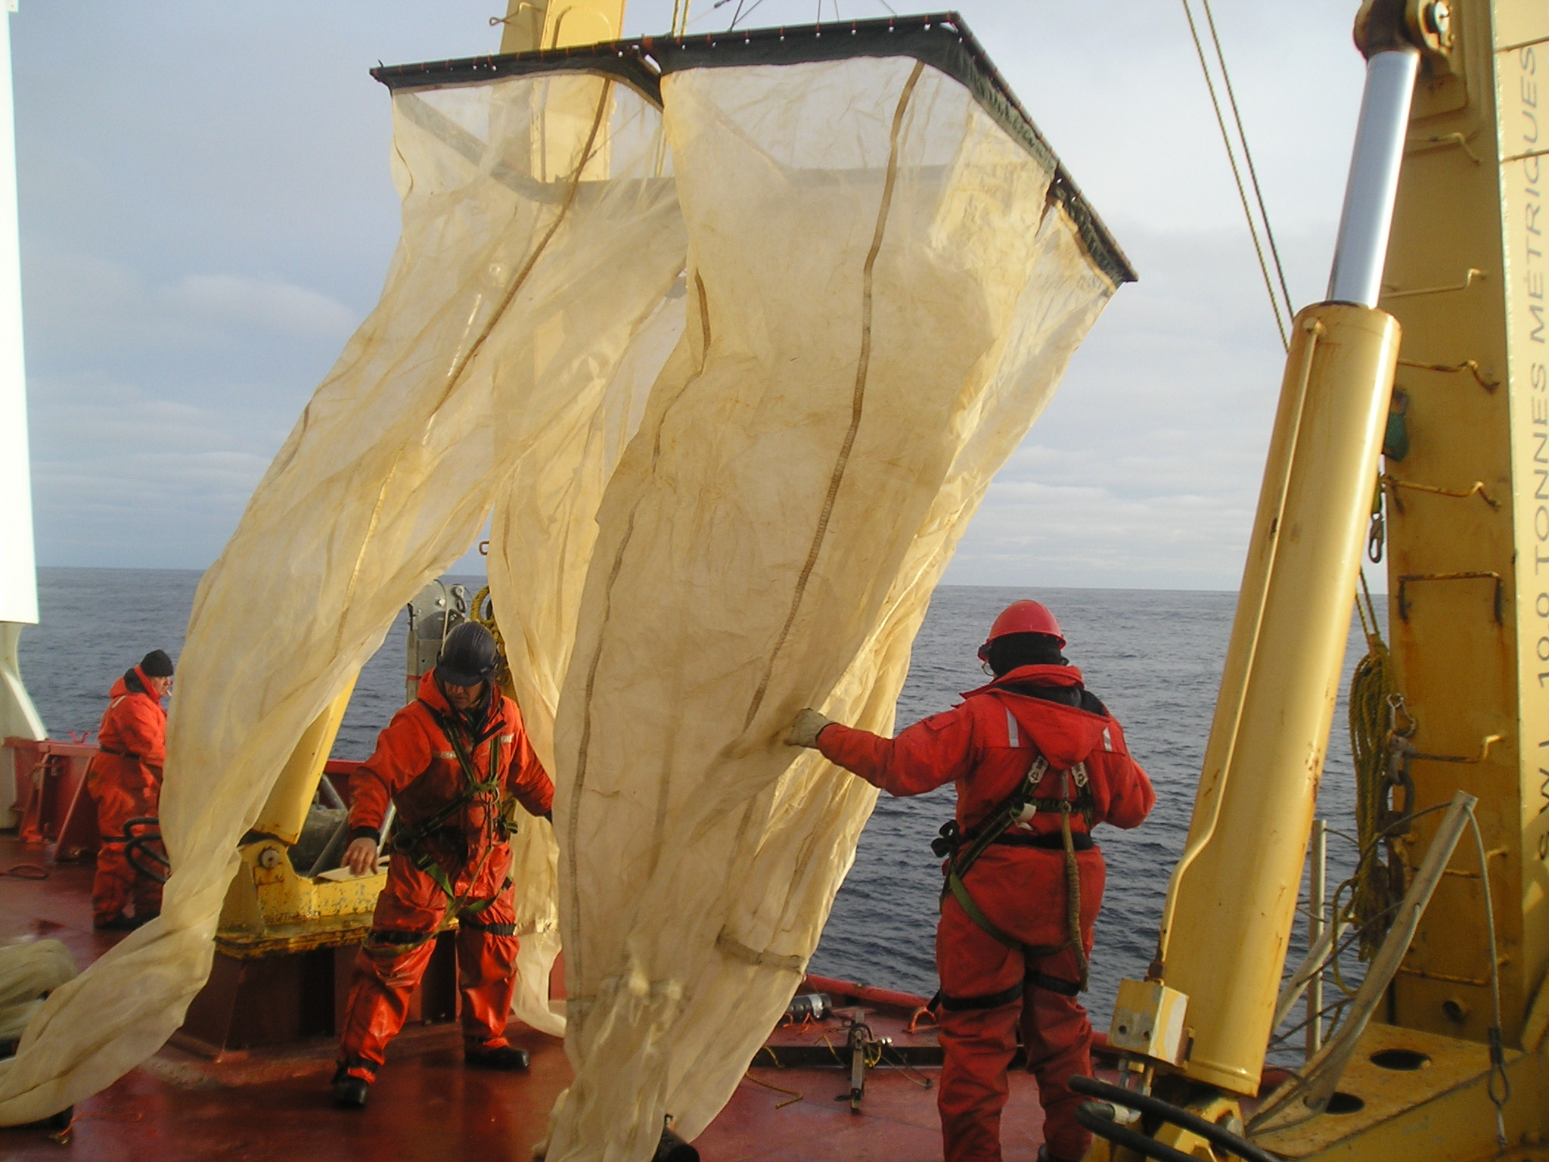
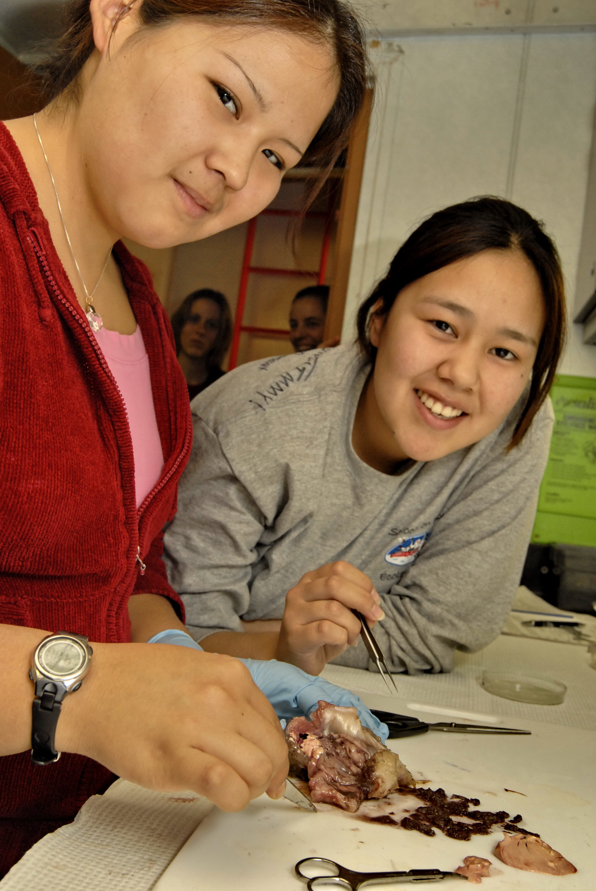
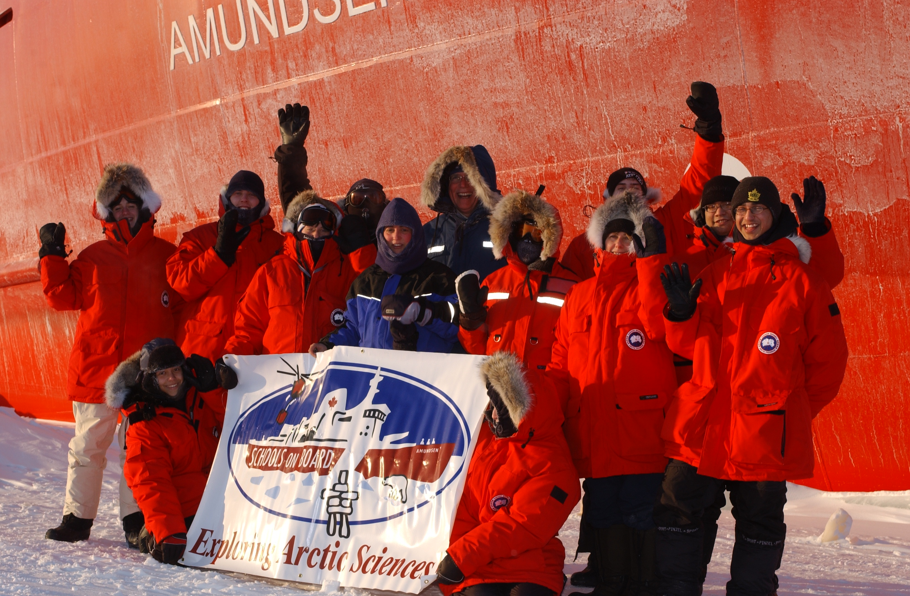
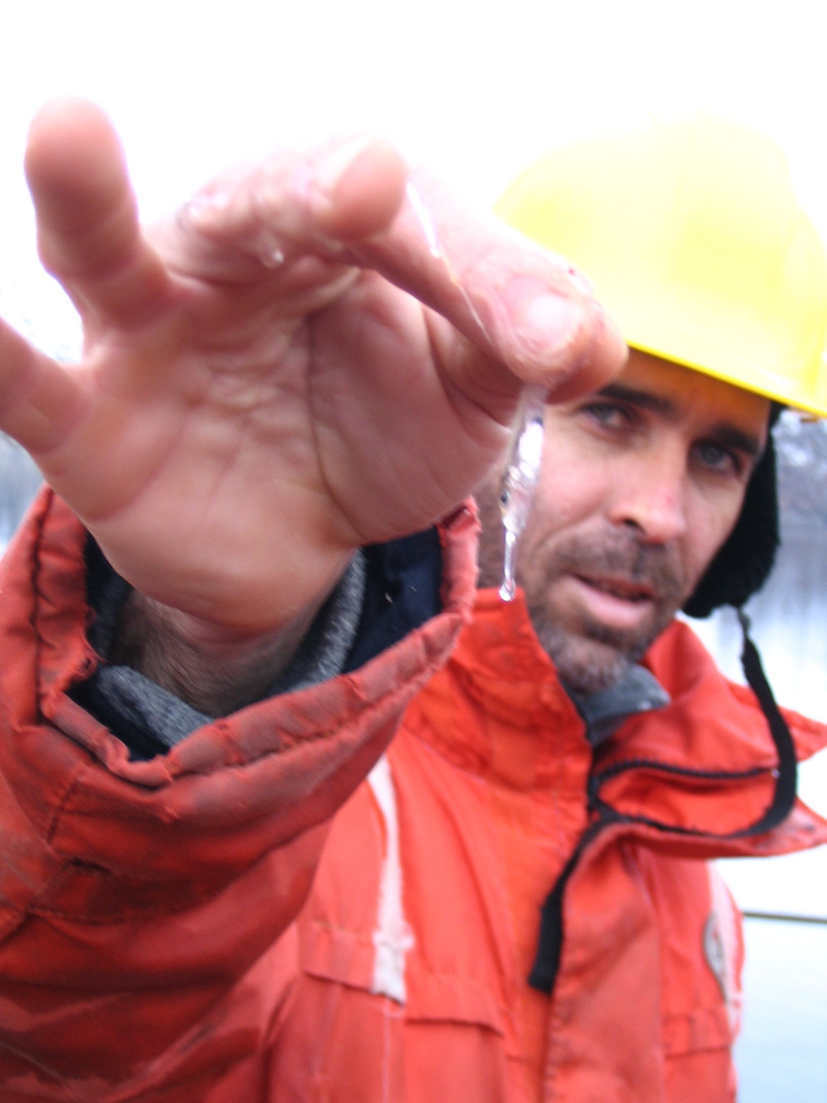
UofM Outreach Award
EECOM Award of Excellence in EE
Bridging Arctic Research & Science Education
Notes:
The Schools on Board program is an outreach program, based out of the University of Manitoba, (Winnipeg, Manitoba). The goal of the program is to bridges classroom science and scientific research, by providing exciting Arctic field opportunities for high school students (16 to 18 years old) and teachers onboard the Canadian research icebreaker (CCGS Amundsen).

Slide 4
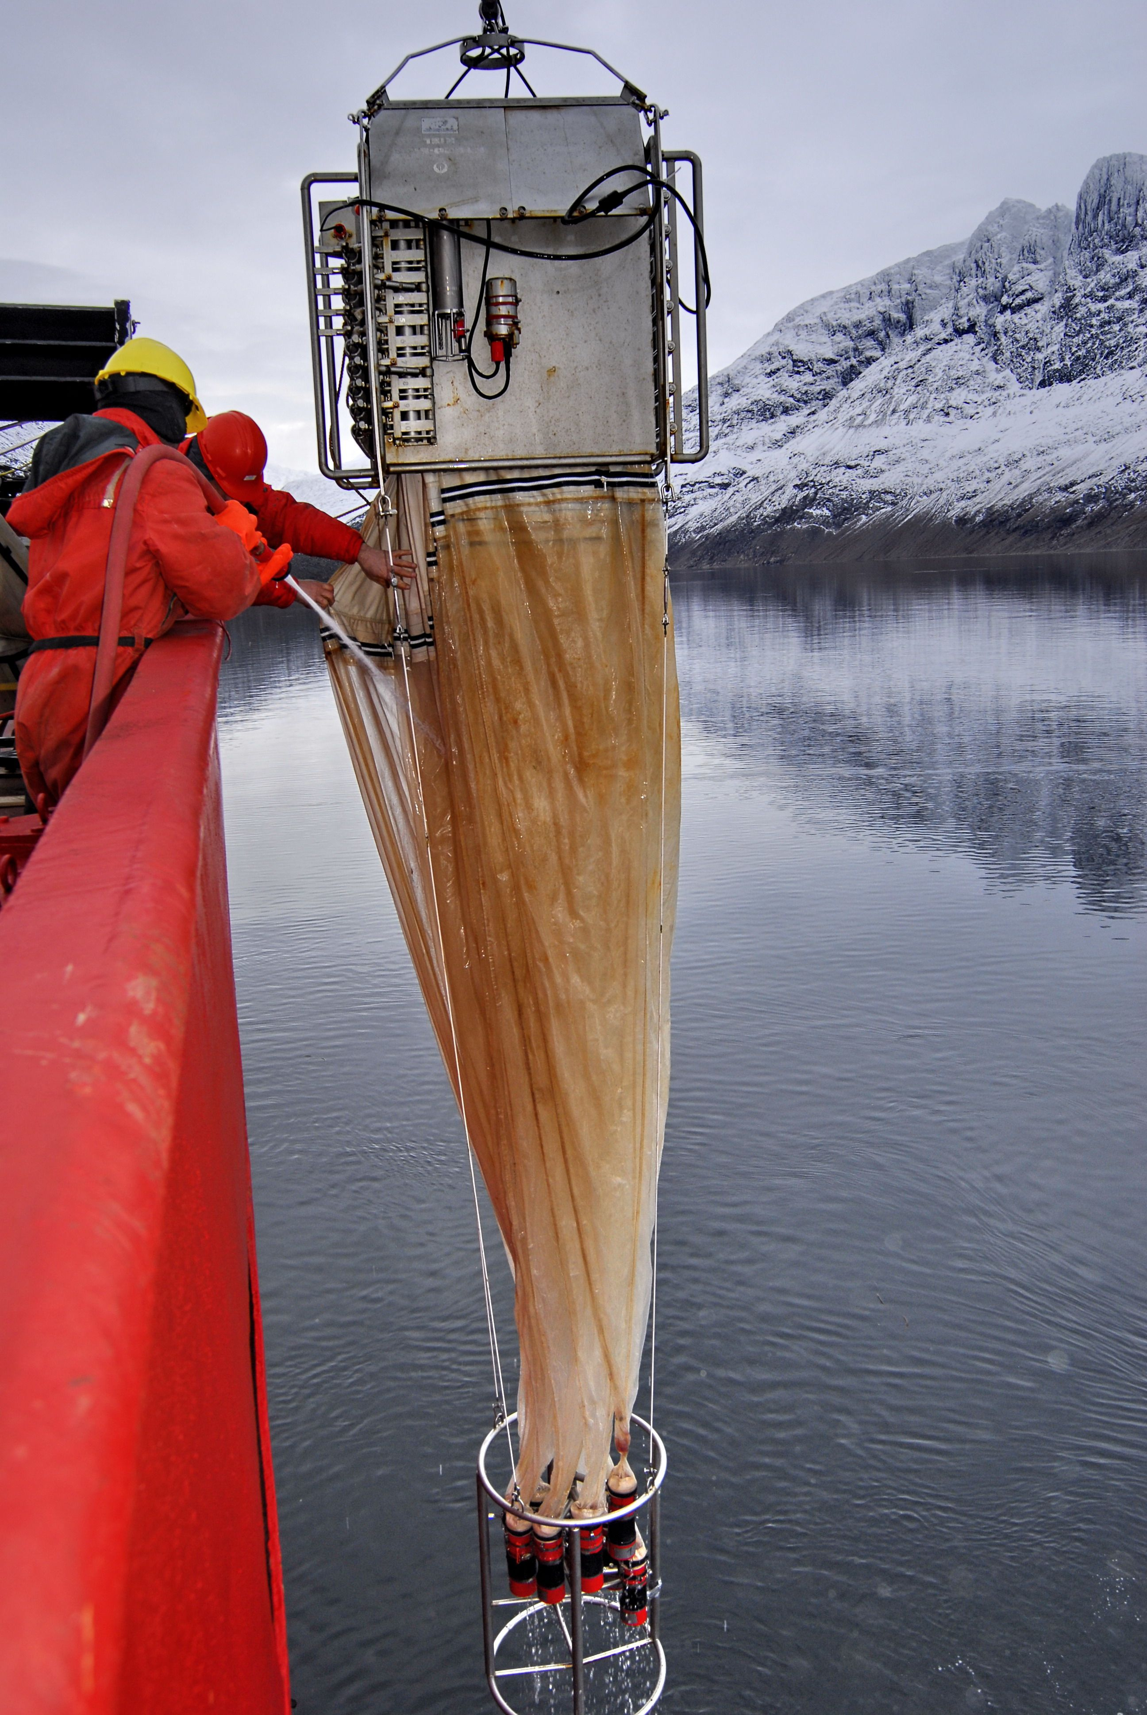
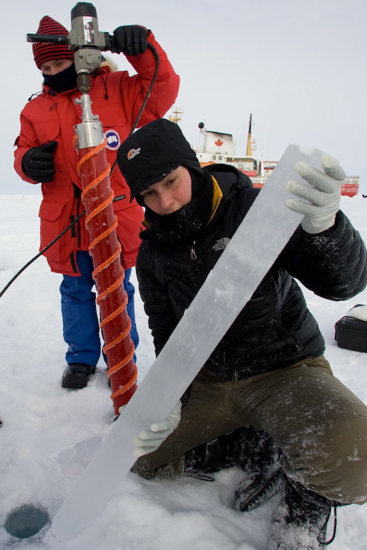
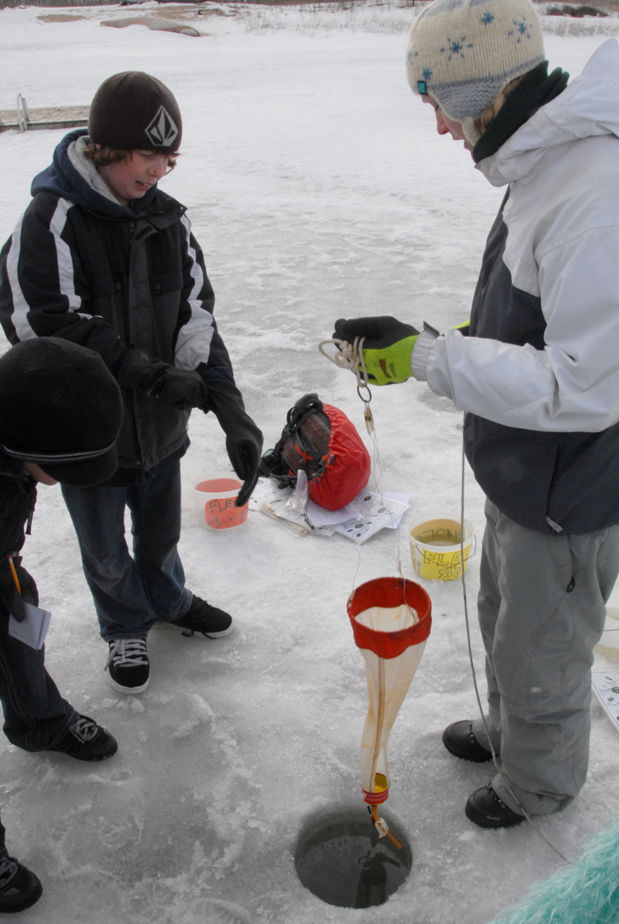
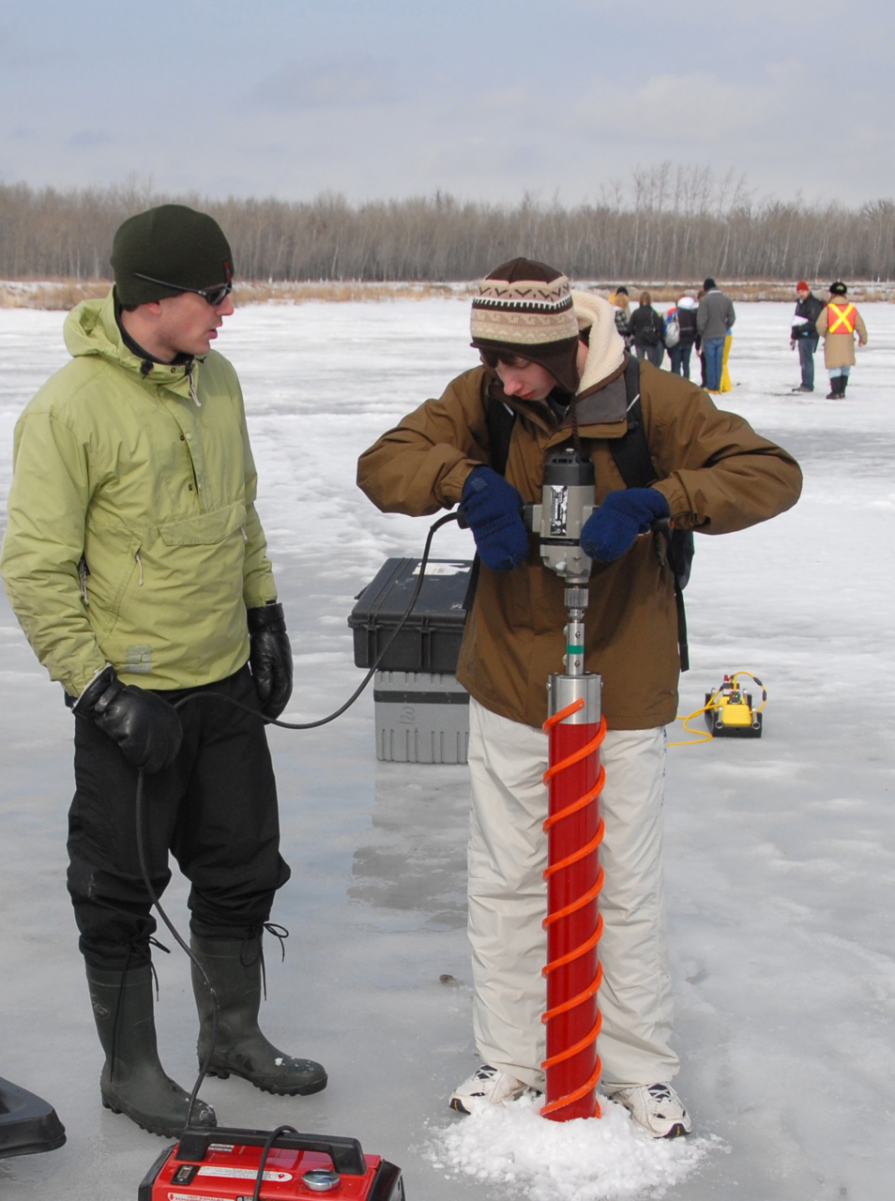
Program Goal
Promote science education through authentic & simulated field experiences!
IN the Arctic
IN an outdoor setting or lab
Notes:
- newish initiative for SonB
- work/collaborate closely with ArcticNet Student Association
- interested in doing any type of outreach and you require support (some funds can be allocated to reimburse or resources or advice?)
- in Winnipeg we host an annual event ‘called’ Arctic Science day where we literally bring the research that is conducted either off the ship or the Arctic to high school students.
80 -100 high school students com for a day and are introduced to Arctic Sciences through hands on demonstrations or workshops facilitated by CEOS graduate students.
Event is successful because of the support from Pis for their students to do this, collaboration with an outdoor education facility, and the participation and enthusiasm of the graduate students.
Great for scientists to get out; team building; fun;
e

Slide 5
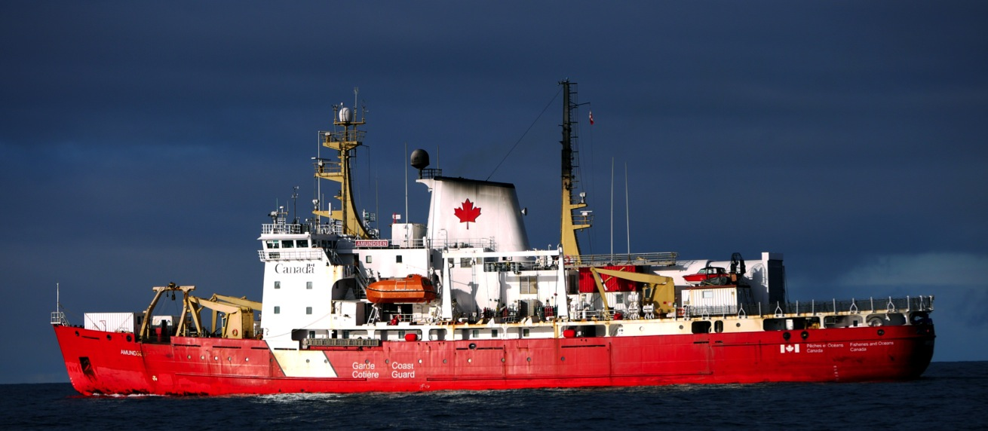
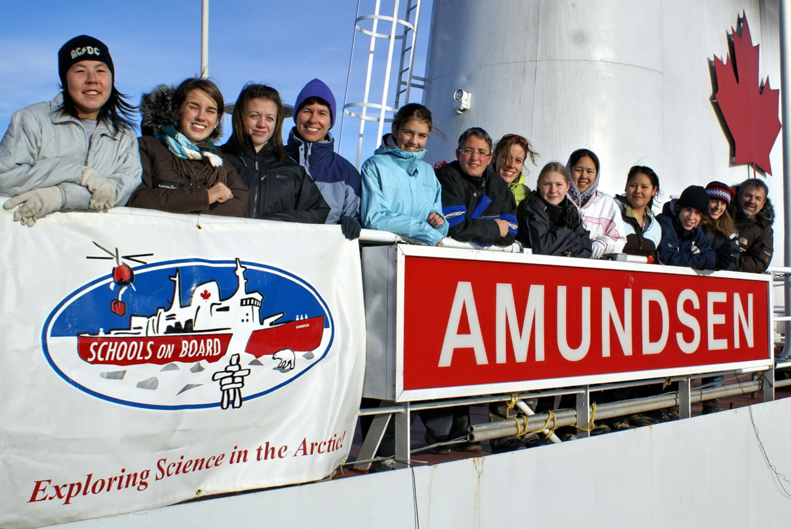
Field Program
Field and Lab Work
Lectures and Demonstrations
Community Visits
Notes:
Field Program is highly successful.
It is the reason the program is called ‘Schools on Board’
Each participant represents a school

Slide 6
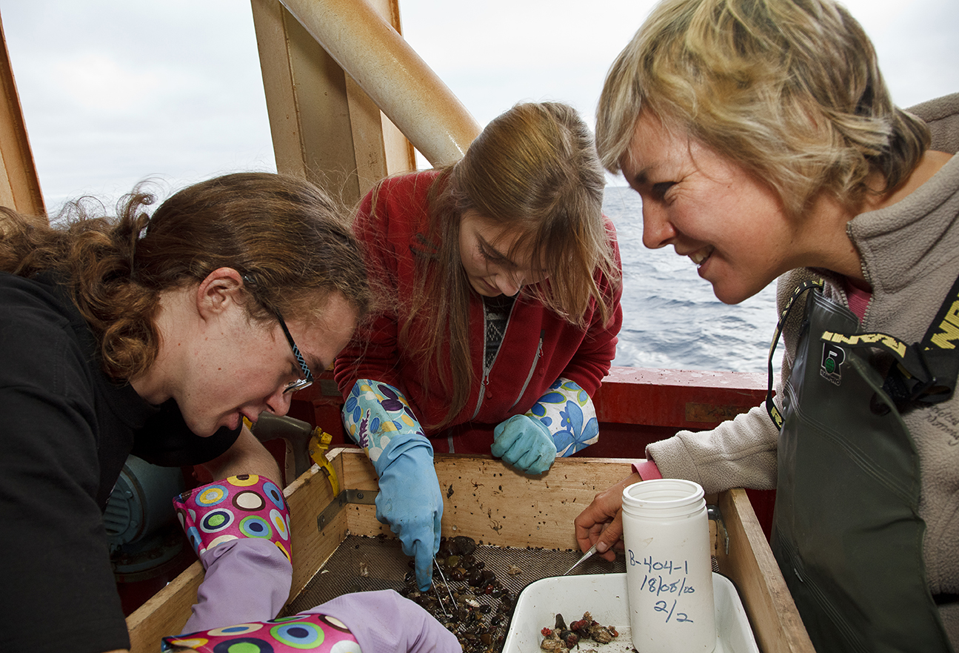
Bringing Students and Scientists Together

Slide 7
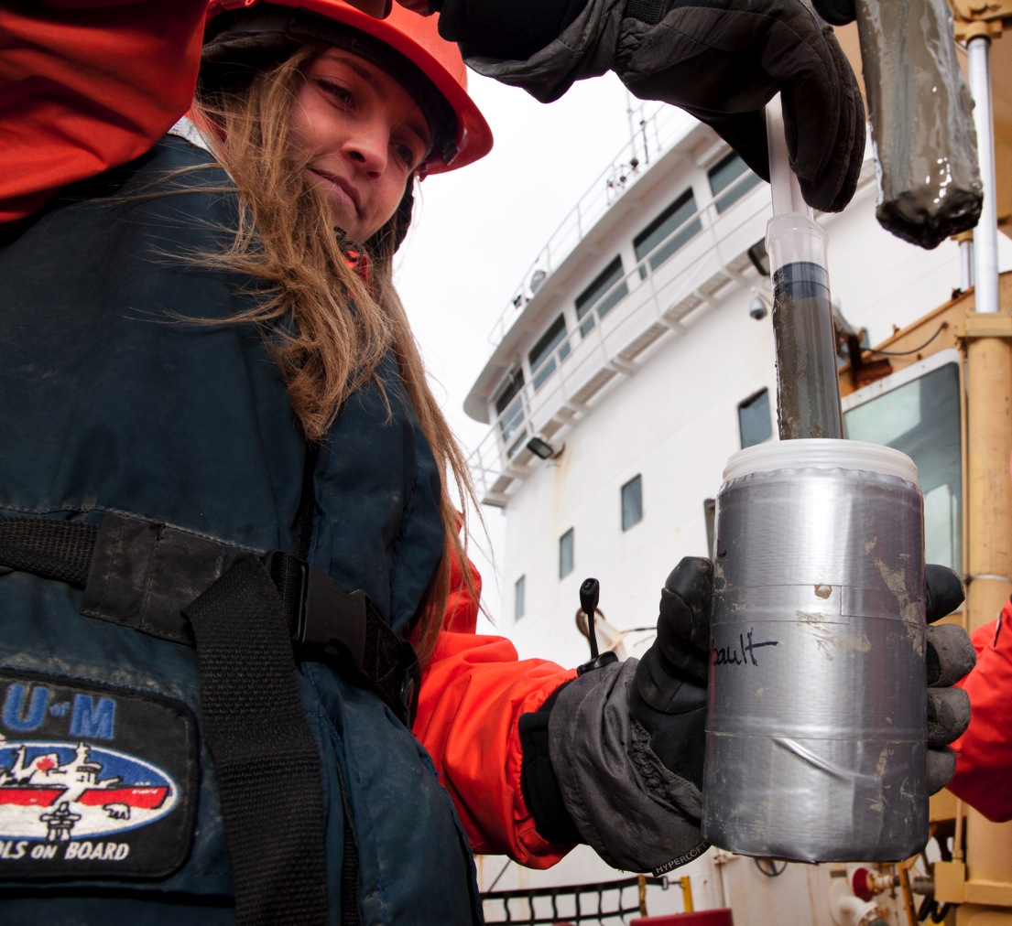

Slide 8
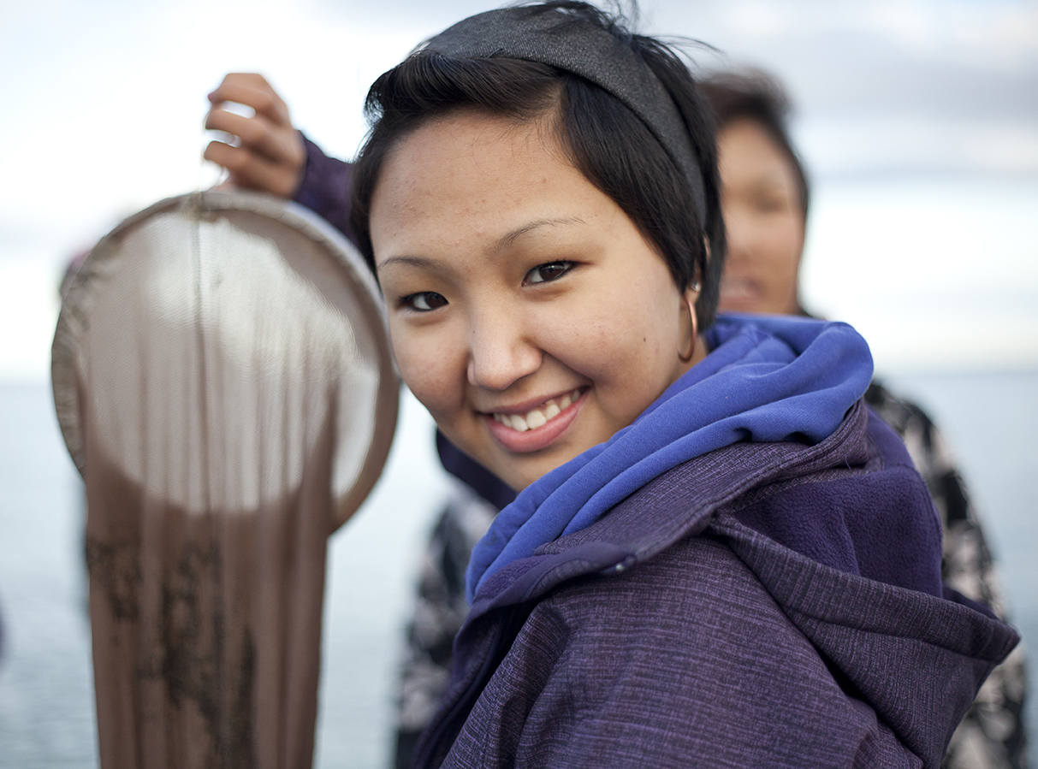

Slide 9
Guiding Evaluation Questions:
What do teachers do differently as a result of the program?
How does this program benefit scientists?
What do participating schools implement (do) as a result of the program?
How have students’ attitudes and values of climate change research of changed?
In what ways did the program empower the students?

Slide 10
1. What do teachers do differently as a result of the program?
Indicators
Examples of how they incorporate experience into lesson plans
# avenues where they have shared learning
Examples of how the program changed them on a personal level
Examples of change in perception or attitudes towards scientific research

Slide 11
Tools:
Interviews with current and past teachers – in person on ship; follow-up after program
Participant survey
School survey

Slide 12
2. How does this program benefit scientists?
Indicators
Examples of how on their onboard experience is different
Number of scientists who did outreach for the first time
Examples of what they learned from participants

Slide 13
Tools:
Scientist Survey

Slide 14
3. What do participating schools implement (do) as a result of the program?
Indicators
List of outreach activities
Number of presentations with number of participants & target audiences
List of activities and changes that occurred as a result of participation in the program
Number of schools that have implemented 75% of their outreach plan

Slide 15
Tools:
School survey
Post-event interviews – comparison with outreach plan

Slide 16
4. How have students’ attitudes and values of climate change research of changed?
Indicators
Examples of changed perceptions about climate change research
Number of students expressing an increased awareness of climate change
Number of students expressing an increased interest in research

Slide 17
Tools:
Focus group
Journal
Participant surveys

Slide 18
5. In what ways did the program empower the students?
Indicators
Number of outreach activities conducted after the program – description & type; informal & formal
Number of students who were able to implement a portion of their Climate Change Action Plan
Examples of growth witnessed by parents & teachers

Slide 19
Tools:
Focus group
Participant observations
Parent – online survey
School Evaluation

Slide 20
Challenges
Matching evaluation with goals
Deciding what to and what not to evaluate
‘Wordsmithing’
Operationalizing questions

Slide 21
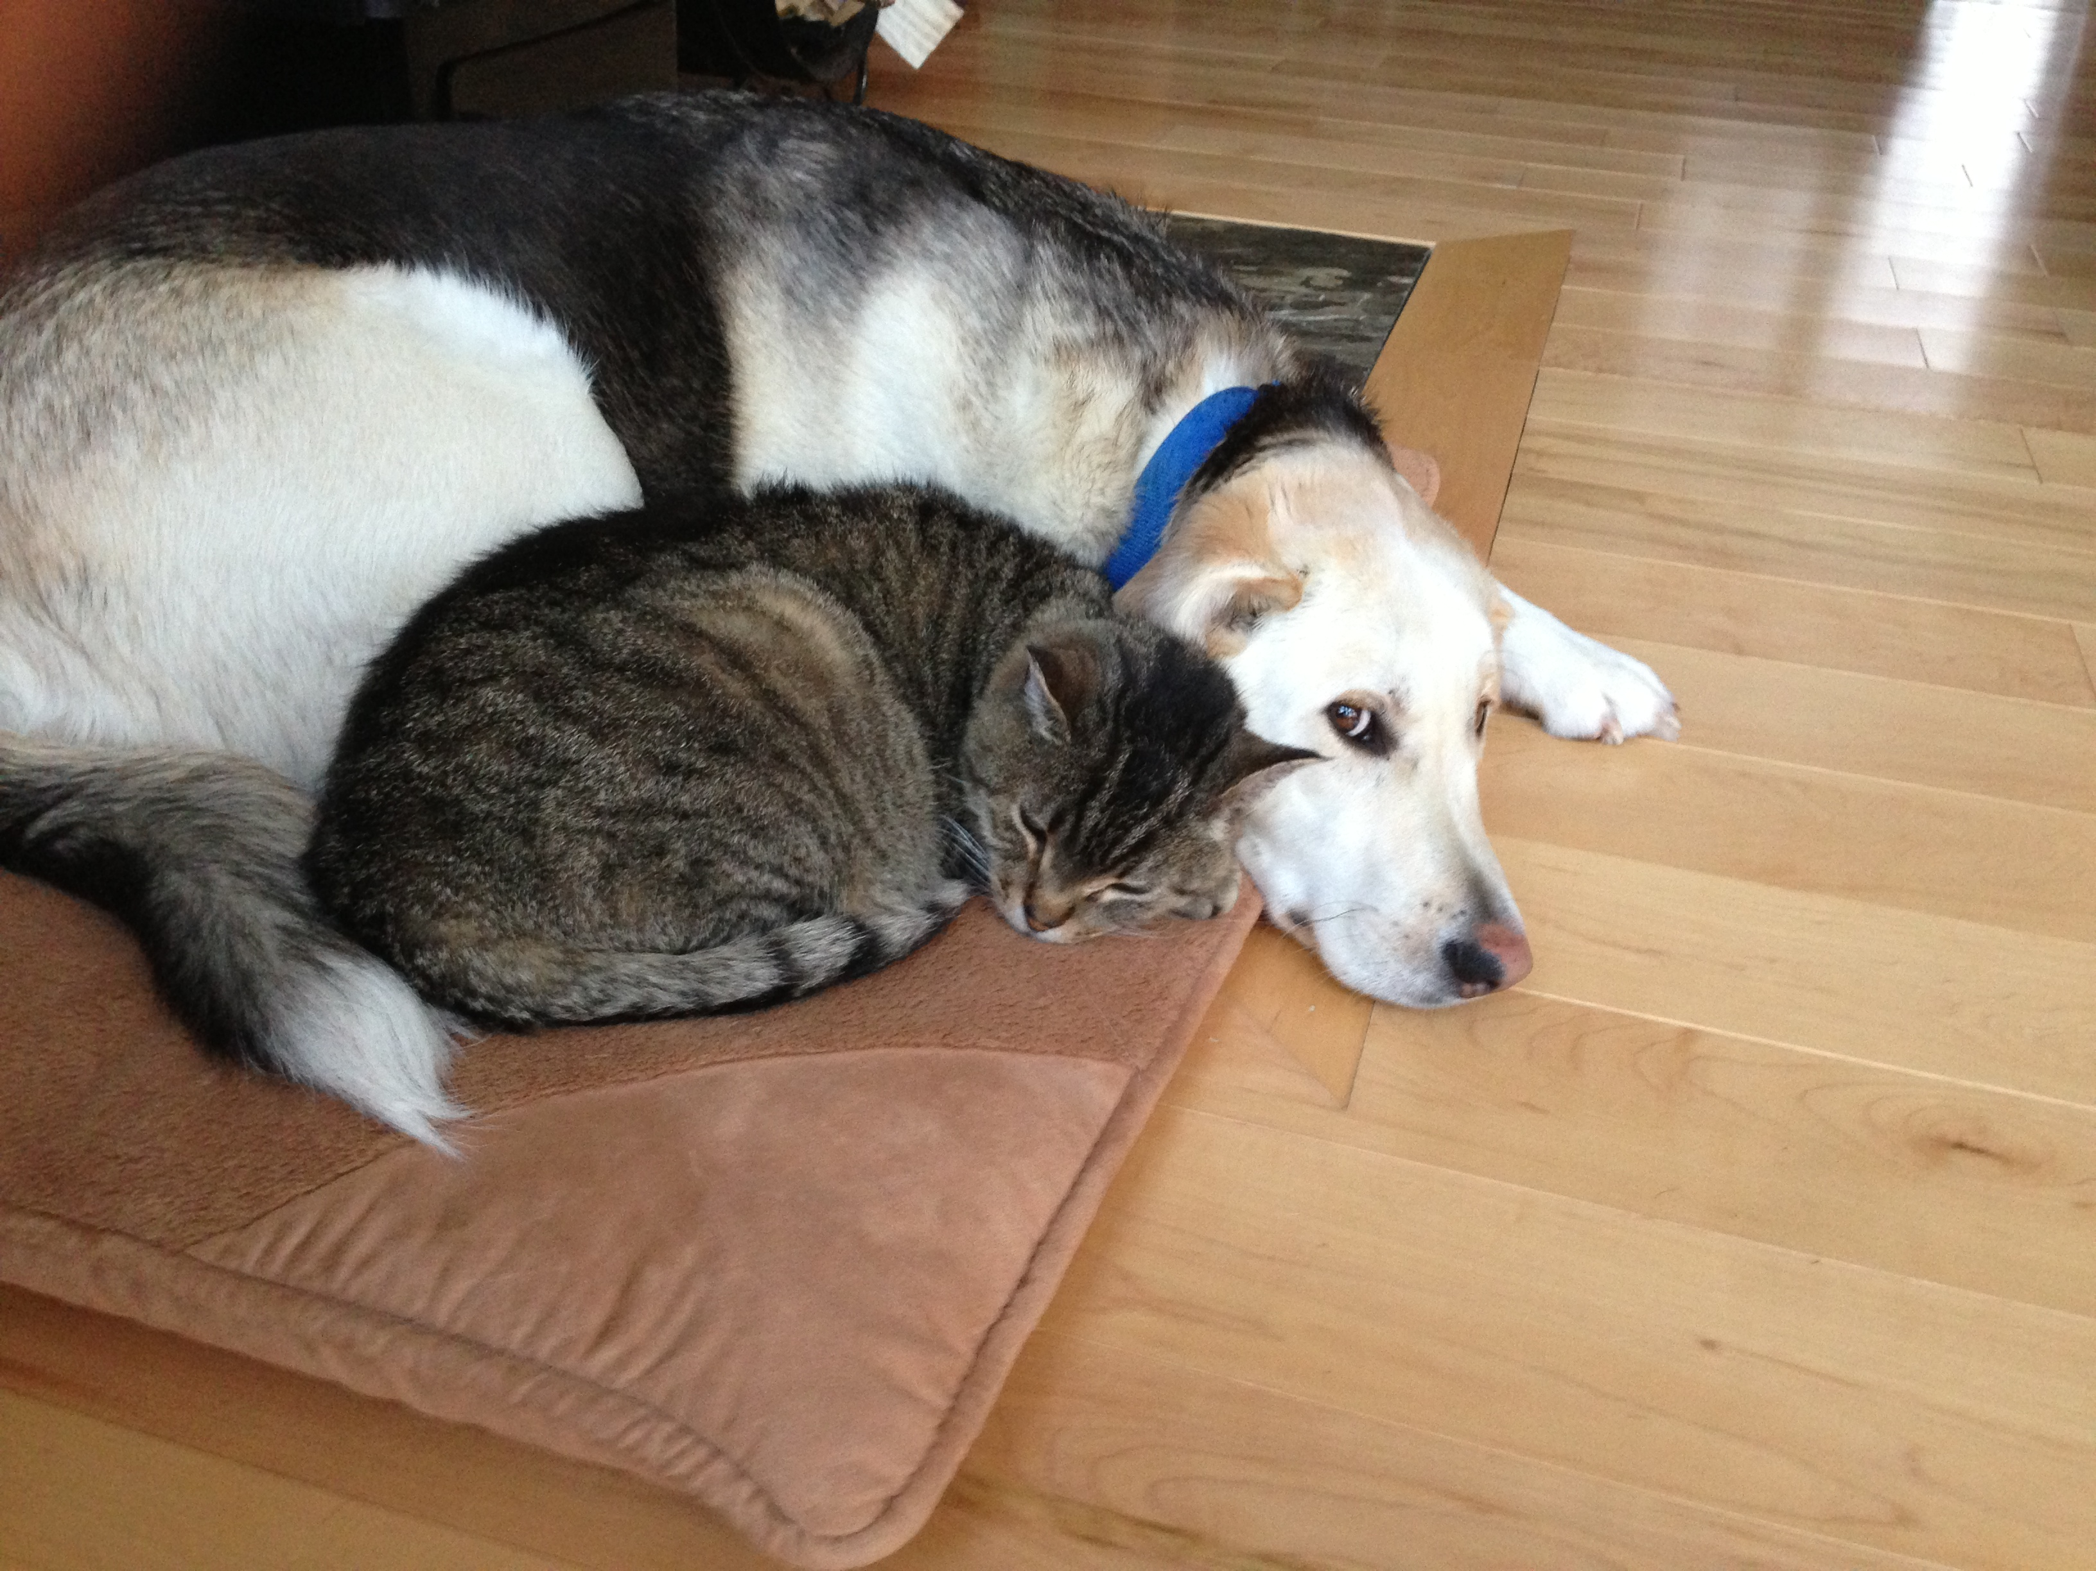

Slide 22
Guiding Evaluation Questions:
4. How have students’ attitudes and values of climate change research of changed?
5. In what ways did the program empower the students?

Slide 23
Next Steps
Follow up with SI students
Create an evaluation plan
Tools
Informed consent
Communication plan
Timeline

Slide 24
Visit us at: schoolsonboard.ca
Field Program
Students
Educators
Scientist
ACCYF
Success Stories
Network
Resources
Notes:
CJ Mundy
Community outreach events.
SonB would like to support these initiatives as well. ASA student submitted a request for funds to help support a local students time to be the liason between the researchers and the community.
Opportunity to engage youth and also communicate what you are doing and make a connection to the people that live in the area that you are studying.

Slide 25
Thank You!

