Slide 1
Empowerment
Evaluation
Key Principles
Lawrence Deane,
Associate Professor
Faculty of Social Work
University of Manitoba

Slide 2
Empowerment Evaluation
Origins:
Participatory Action Research
- Research in social justice settings
- NASA
- Hewlett Packard
- David Fetterman – Pres. 1994
  American Evaluation Society

Slide 3
Empowerment
Process by which people take charge of their environment – physical, economic, social, cultural psychological

Slide 4
Empowerment
Decision-making
Self-perception
Increased resources

Slide 5
Research is an important resource
Consumes time
Shapes perceptions
Releases resources

Slide 6
Research in social settings has always been political. It either maintains, explains, or justifies the status quo - or questions it.
- Rajesh Tandon
Participatory Research in Asia (PRIA)

Slide 7
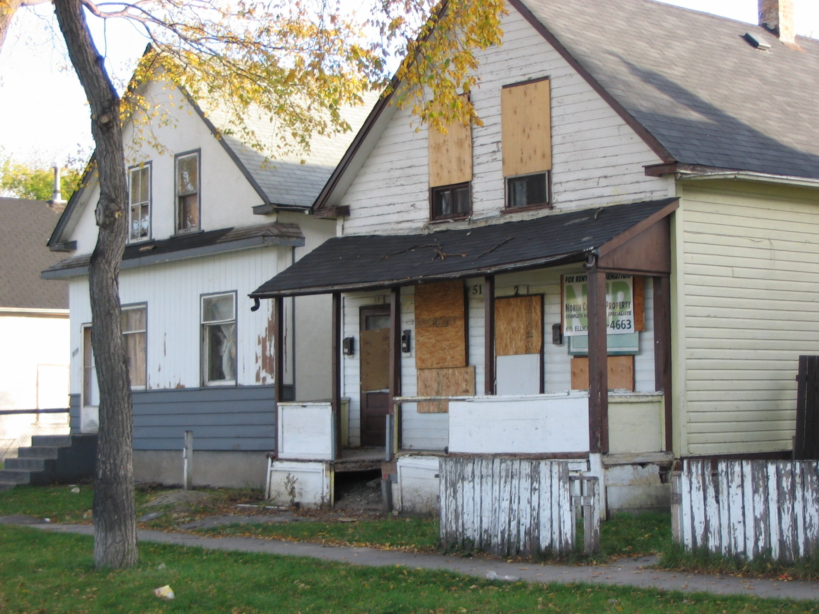

Slide 8
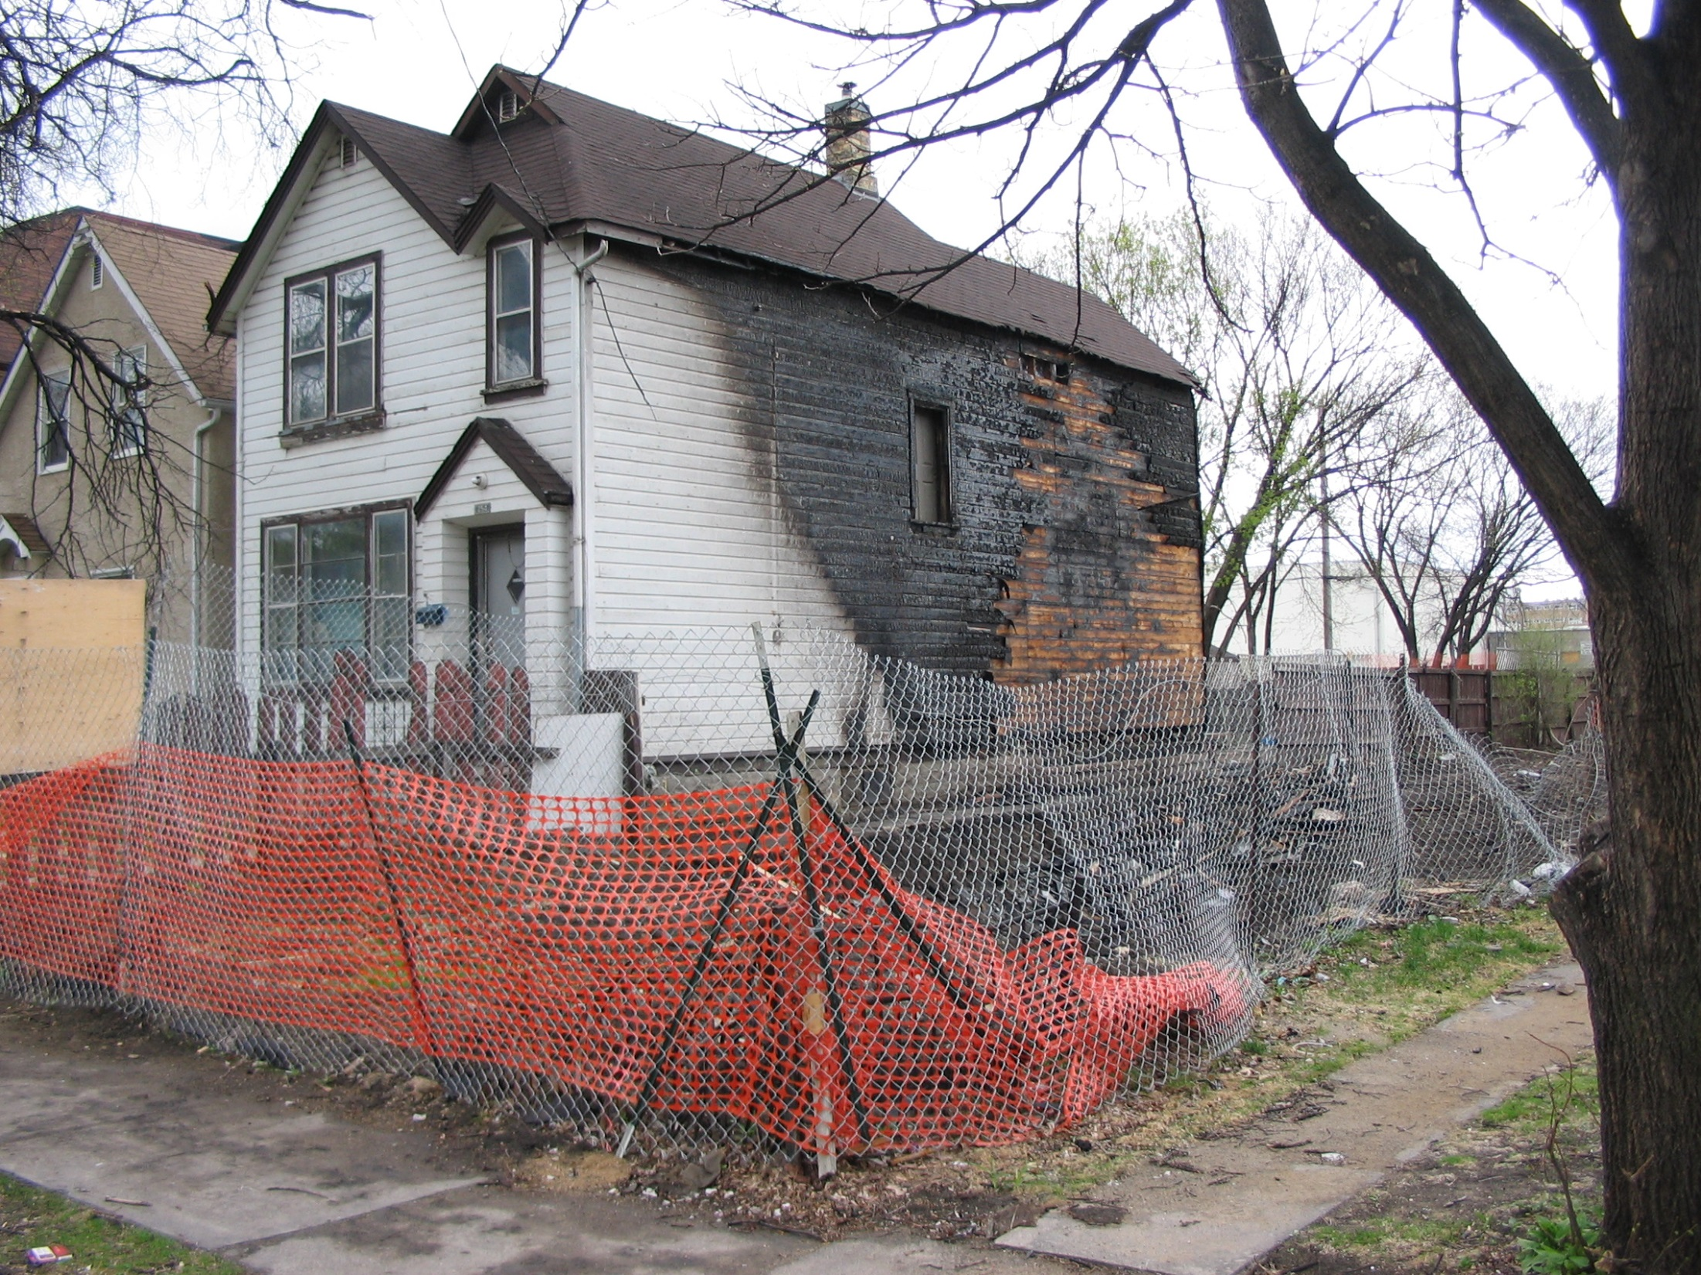

Slide 9
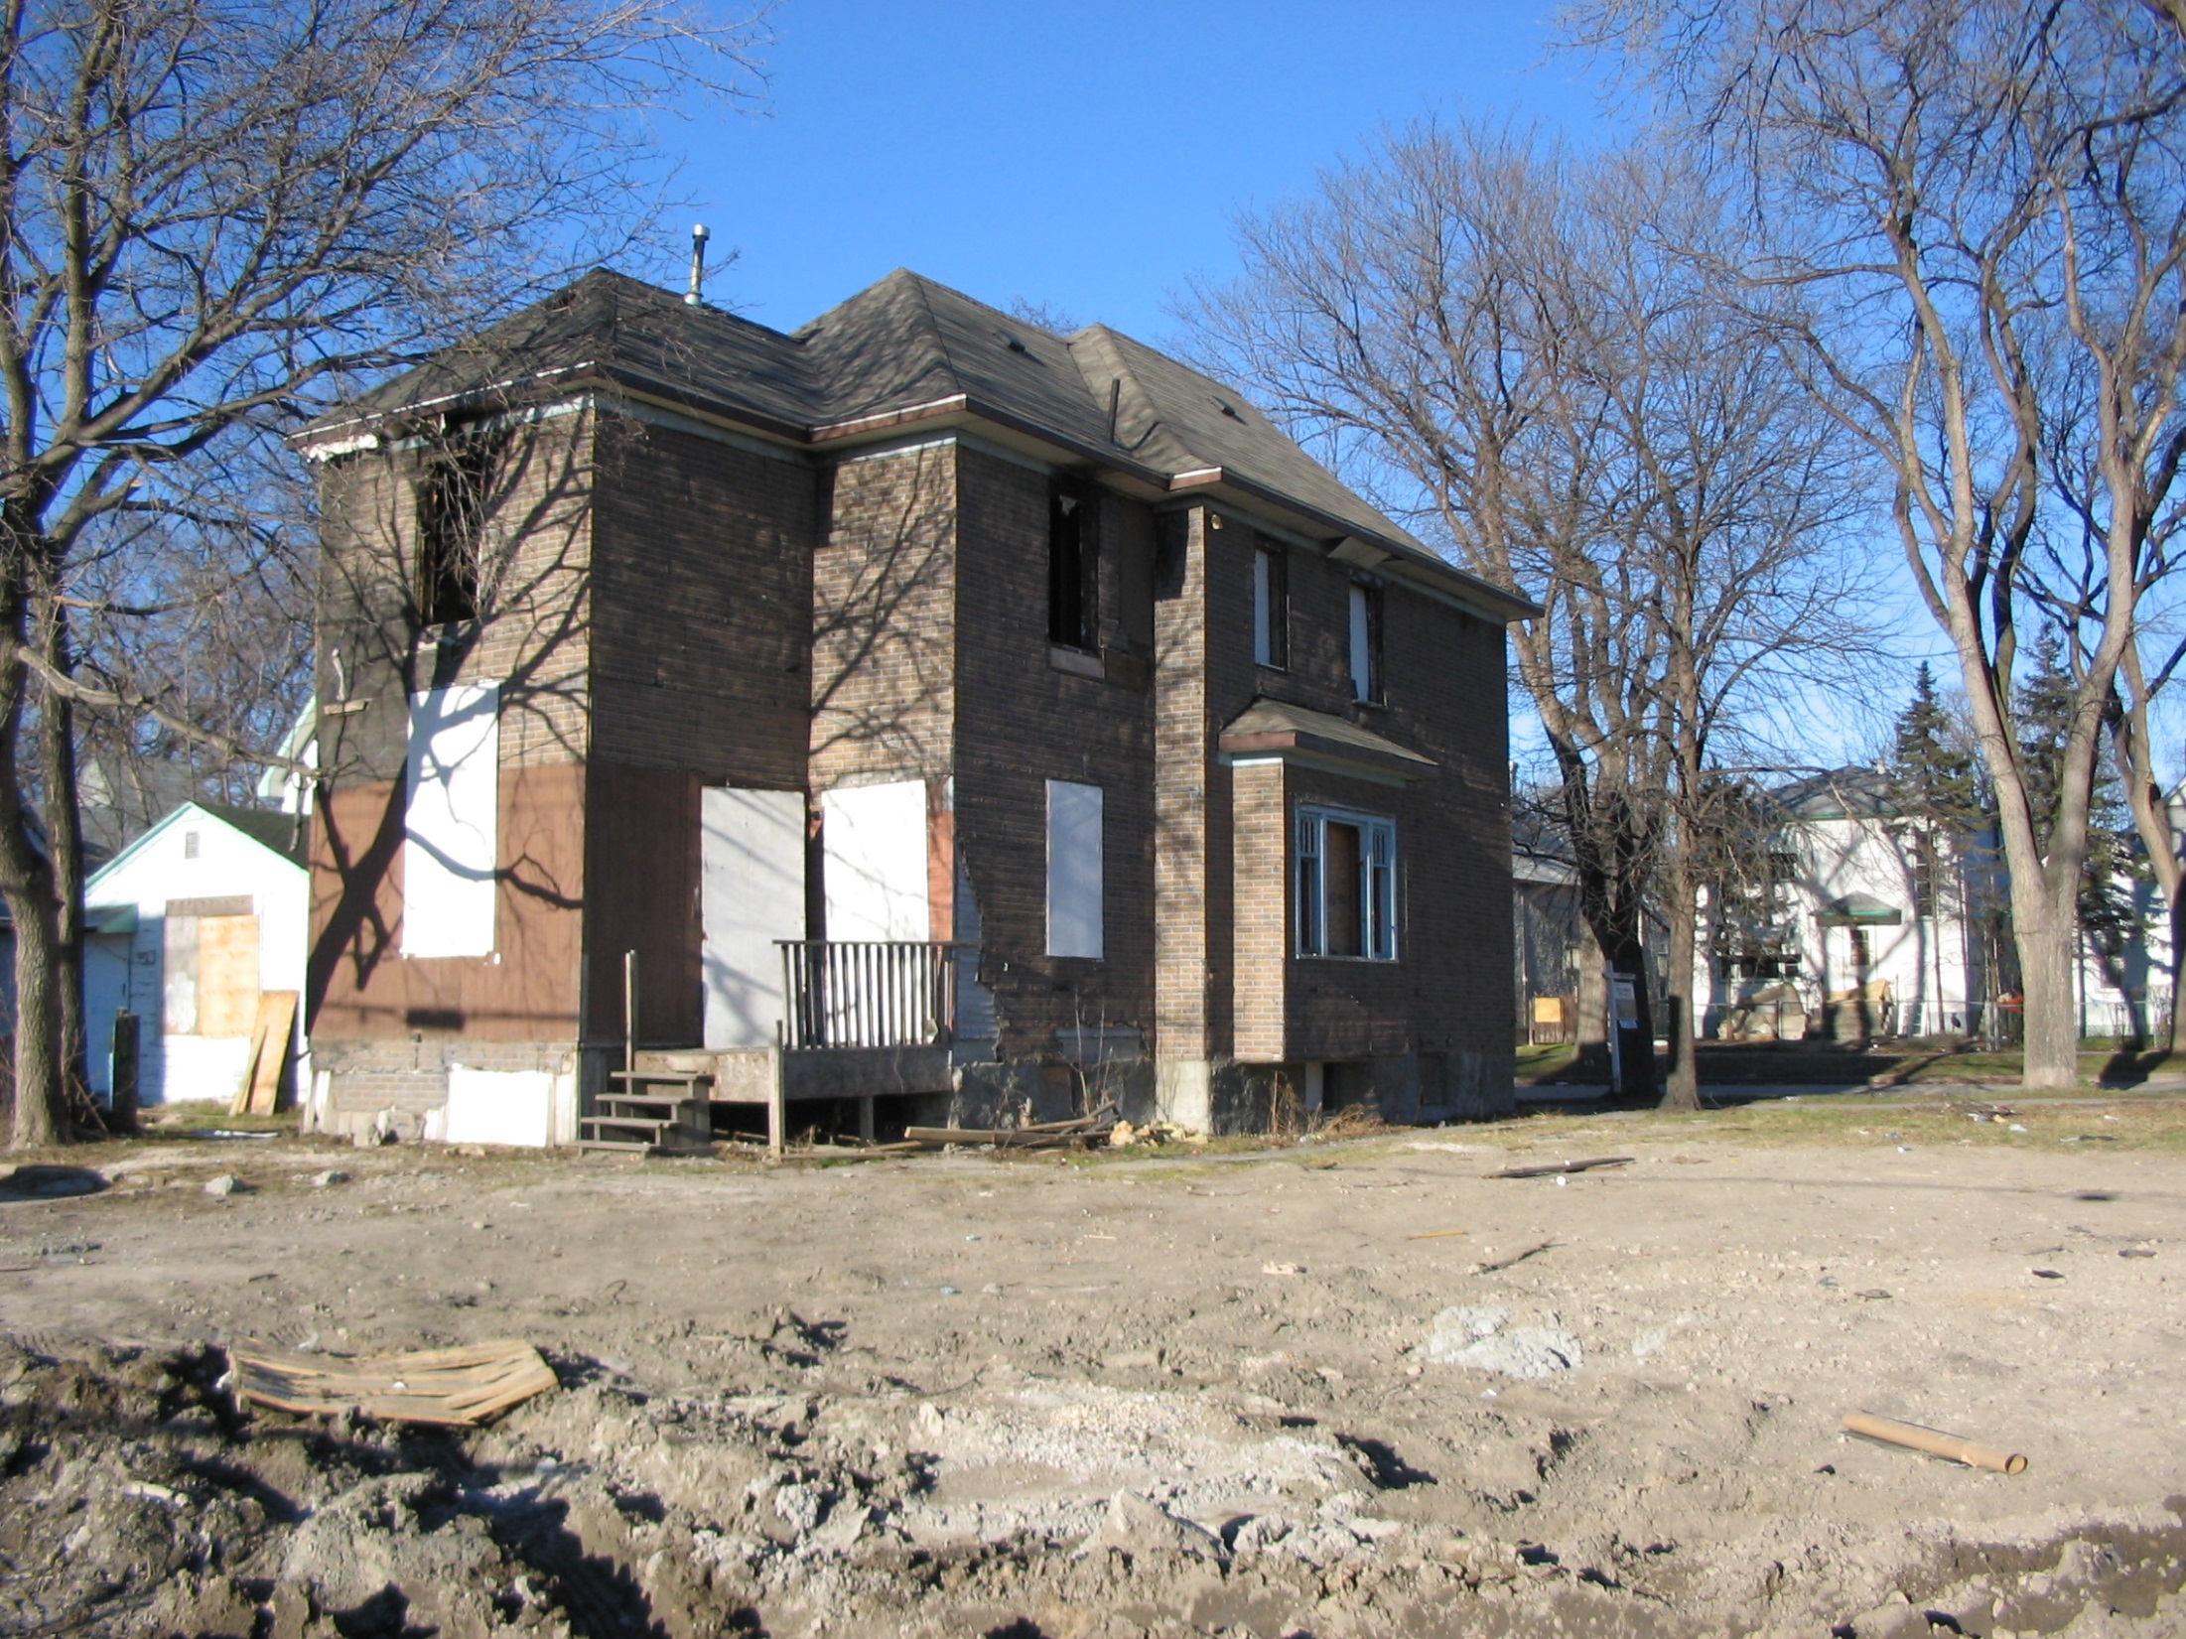

Slide 10
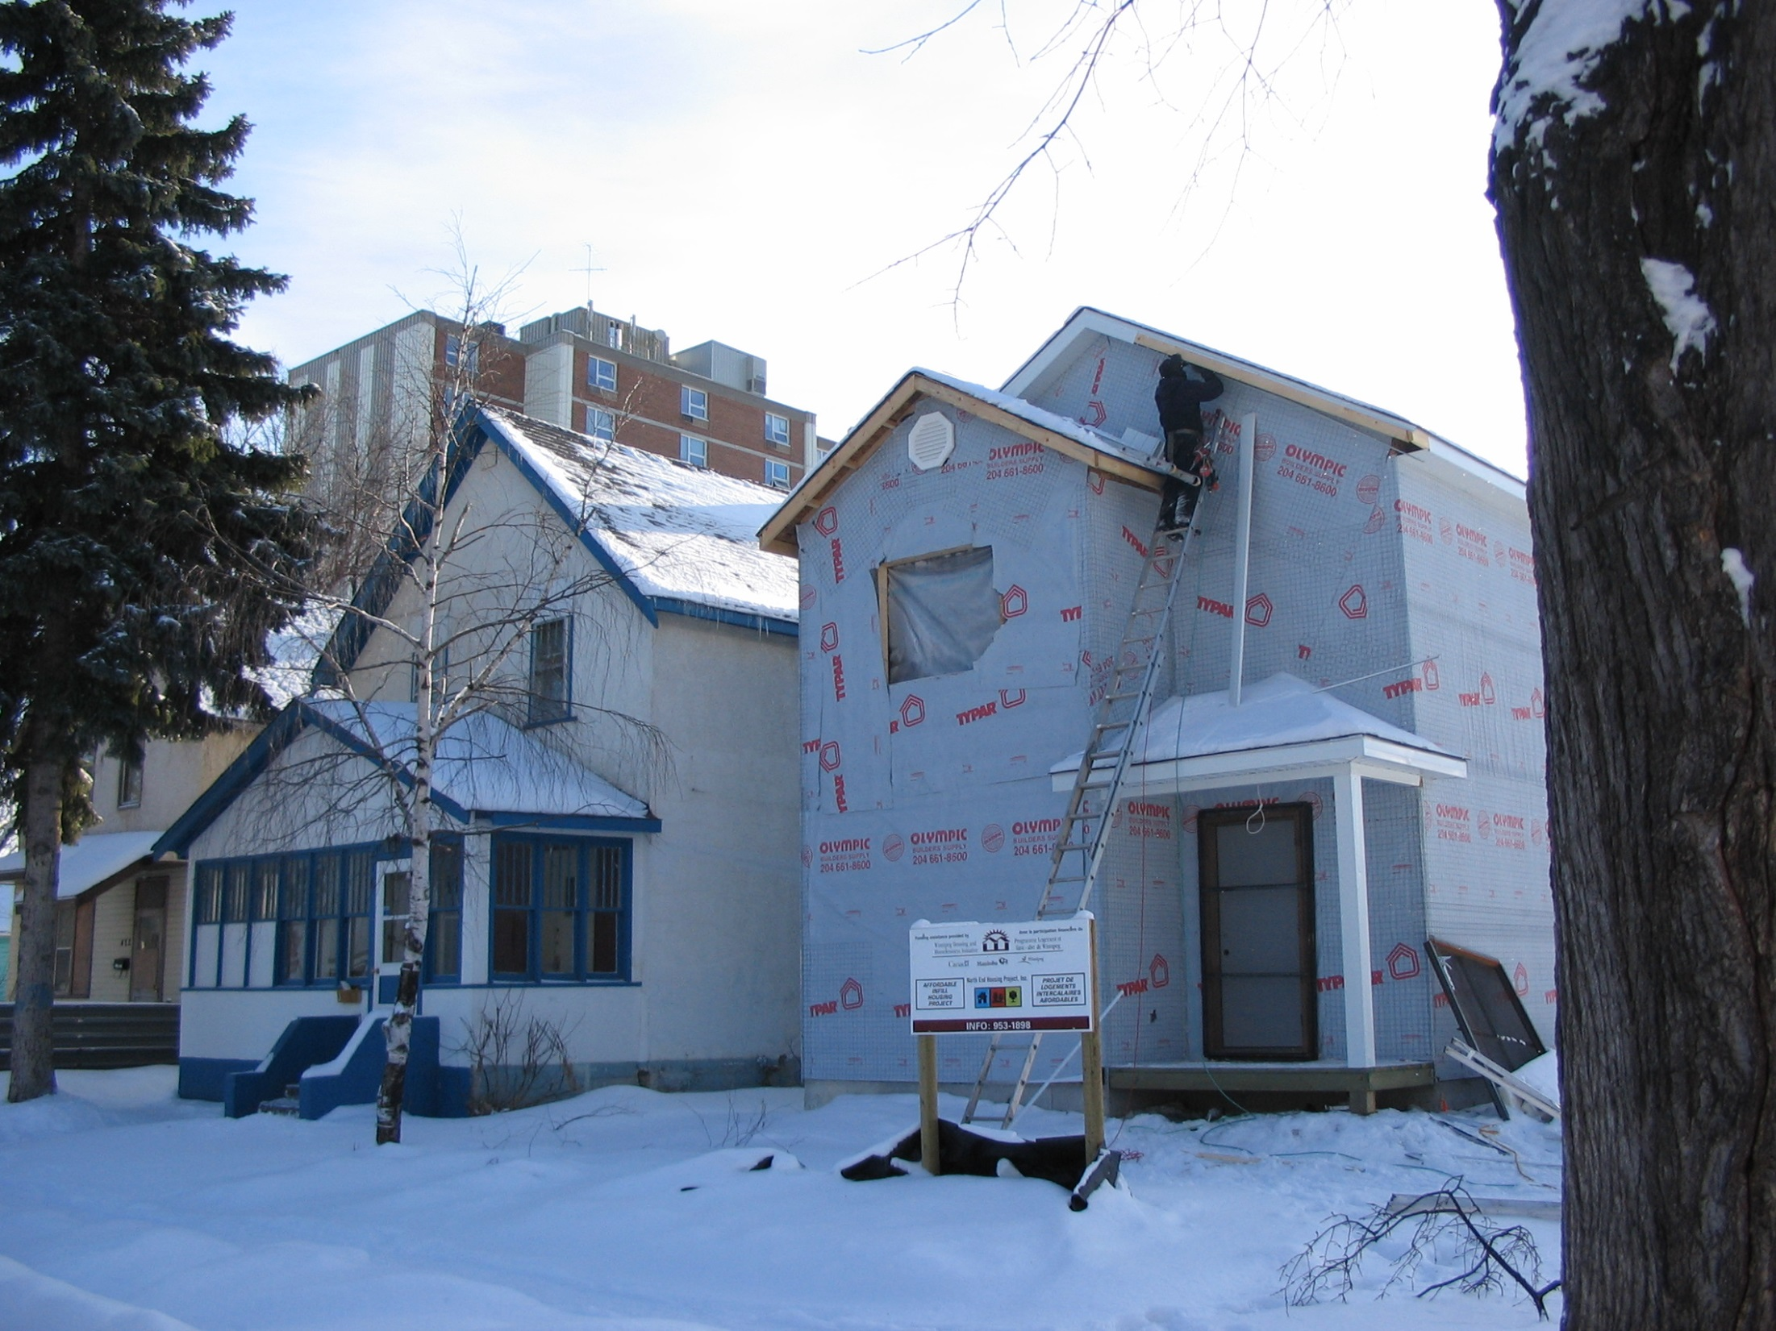
148 Properties

Slide 11
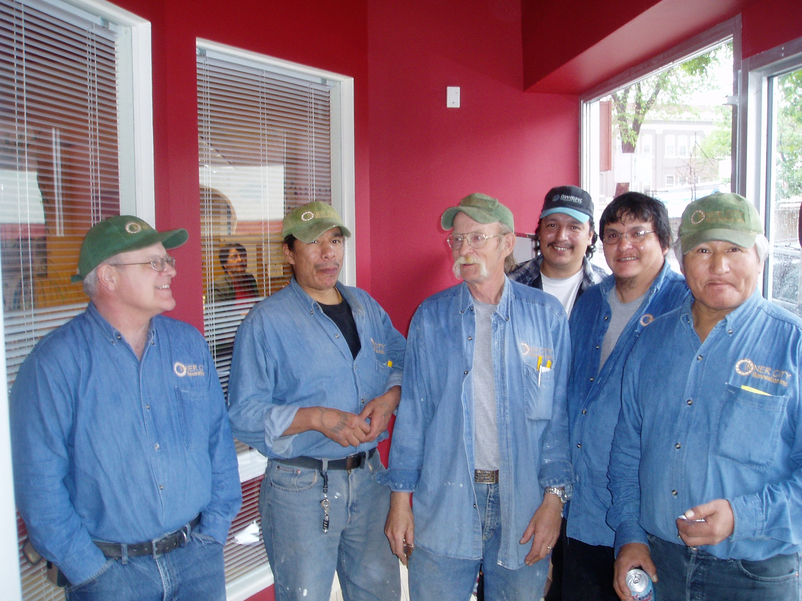

Slide 12
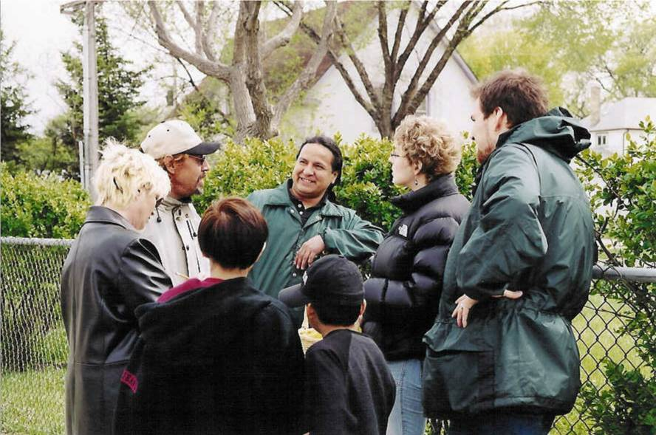

Slide 13
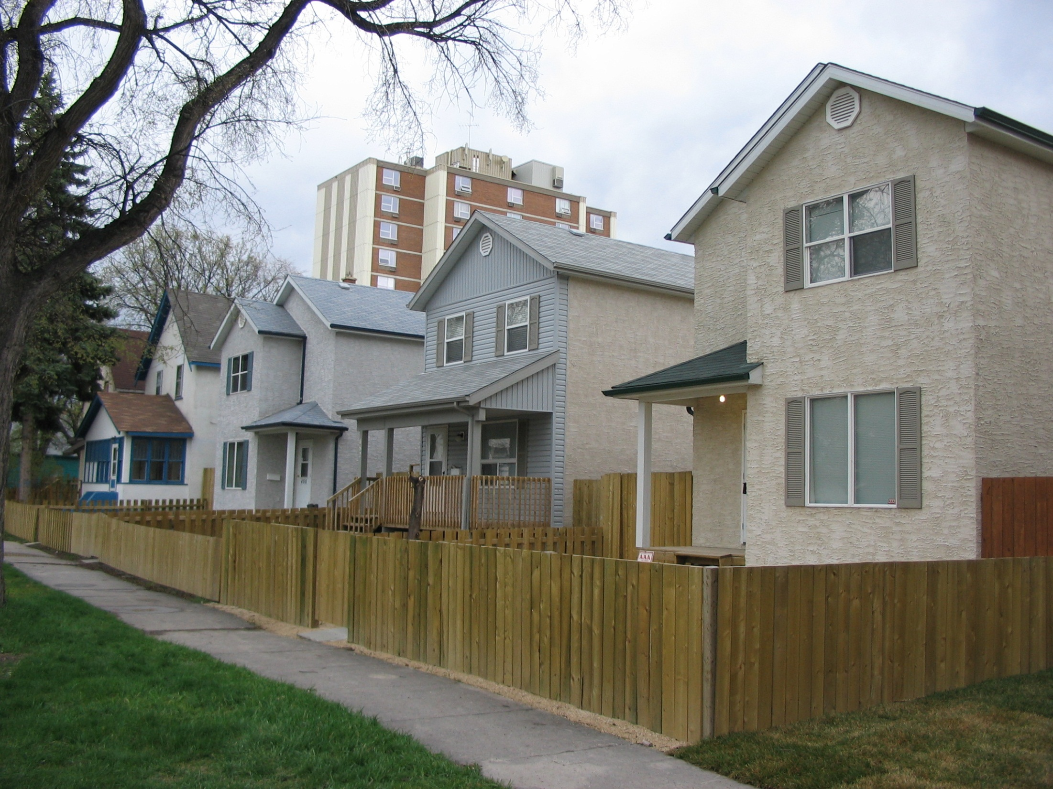

Slide 14
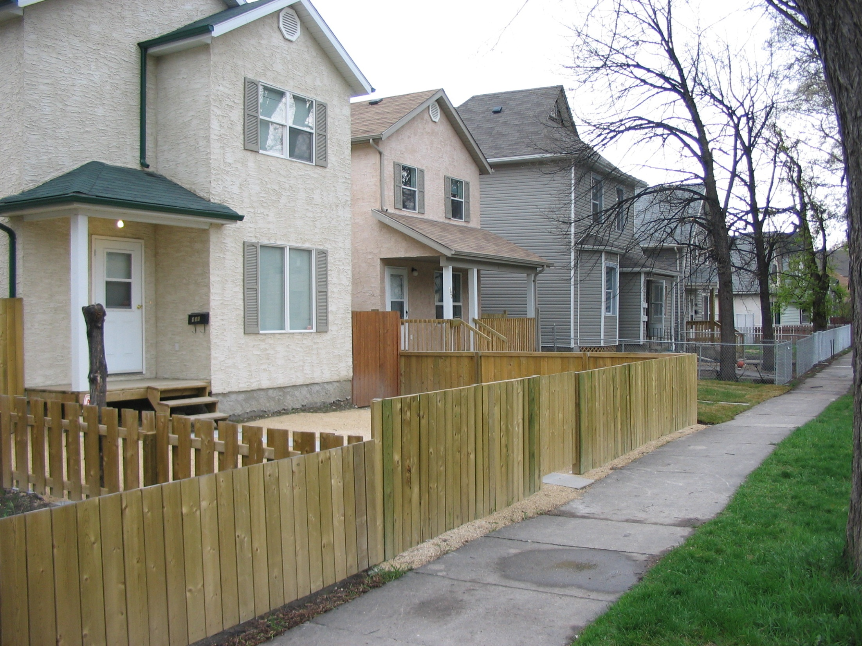

Slide 15
Participatory (Empowering) Evaluation
- Community control of
Purpose
Design
Conduct
Analysis
Use/Dissemination (knowledge mobilization)

Slide 16
220 Laurier Avenue West, Suite 1200
OCAP
Ownership, Control, Access and Possession
OCAP
Ownership, Control, Access and Possession
Sanctioned by the First Nations Information Governance Committee
Report title: OCAP: Ownership,
Control, Access and Possession
© Copyright 2007 National Aborig
inal Health Organization
ISBN: 978-0-9780785-8-4
Date Published: April 2007
OAAPH [now known as the National Aborigin
al Health Organization (NAHO)] receives
funding from Health Canada to assist
it to undertake knowledge-based activities
including education, research and disseminati
on of information to promote health issues
affecting Aboriginal persons. Ho
wever, the contents and conc
lusions of this report are
solely that of the authors and not attributable
in whole or in part
to Health Canada.
The National Aboriginal Hea
lth Organization, an Aborigin
al-designed and -controlled
body, will influence and advance the health
and well-being of Aboriginal Peoples by
carrying out knowledge-based strategies.
This report should be cited as:
First Nations Centre. (2007).
OCAP: Ownership, Control, Access and Possession
.
Sanctioned by the First Nations Information
Governance Committee, Assembly of First
Nations. Ottawa: National Abor
iginal Health Organization.
For queries or copyright requests, please contact:
National Aboriginal Health Organization
220 Laurier Avenue West, Suite 1200
Ottawa, ON K1P 5Z9
Tel: (613) 237-9462
Toll-free: 1-877-602-4445
Fax: (613) 237-1810
E-mail: naho@naho.ca
Website: www.naho.ca
Under the
Canadian Constitution Act, 1982
, the term Aboriginal Peoples refers to First
Nations, Inuit and Métis people living in Cana
da. However, common use of the term is
not always inclusive of all th
ree distinct people and much of
the available research only
focuses on particular segments of the A
boriginal population. NAHO makes every effort
to ensure the term is used appropriately.
If you have questions or comments about this guide,
please contact us at:
First Nations Centre @ NAHO
Ottawa, ON K1P 5Z9
Tel: (613) 237-9462
Toll-free: 1-877-602-4445
Fax: (613) 237-1810
E-mail: fnc@naho.ca
www.naho.ca
OCAP
Ownership
Control
Access
Possession
Sanctioned by the First Nations Information Governance Committee

Slide 17
Reasons for Community Control (Empowerment)
Ethics
Epistemology
Effectiveness

Slide 18
Reasons for Community Control (Empowerment)
Ethics
  Respectful
  Non-coercive
  Confidentiality
  Reports with integrity
  Redistributes power

Slide 19
Epistemology – study of methods, validity, and scope of knowledge
How to develop accurate knowledge
How do you know it is accurate
Participatory methods build authentic knowledge

Slide 20
Reasons for Community Control (Empowerment)
Ethics
Epistemology
Effectiveness

Slide 21
Participatory Action Research
Community carries out research on itself
Empowerment Evaluation
Community evaluates its own work
/its own programs

Slide 22
Role of the Evaluator
Facilitator
Technical resource person

Slide 23
Assumptions
All stakeholders - interest in program improvement
Funders, researchers, staff form an evaluation ‘community’
Commitment to competent social science
All research is vulnerable to bias

Slide 24
Participatory (Empowering) Evaluation
- Community control of
Purpose
Design
Conduct
Analysis
Use/Dissemination (knowledge mobilization)

Slide 25
Participatory (Empowering) Evaluation
- Community control of
Purpose
Design
Conduct
Analysis
Use/Dissemination (knowledge mobilization)

Slide 26
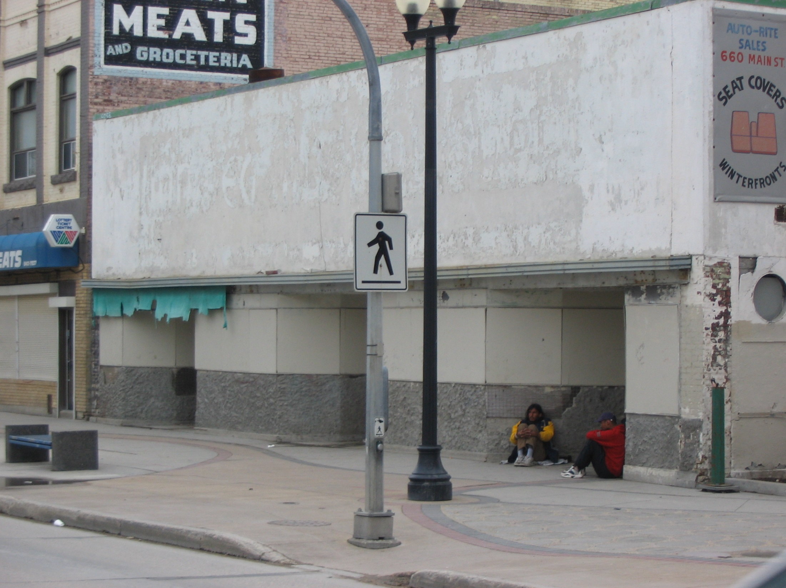

Slide 27
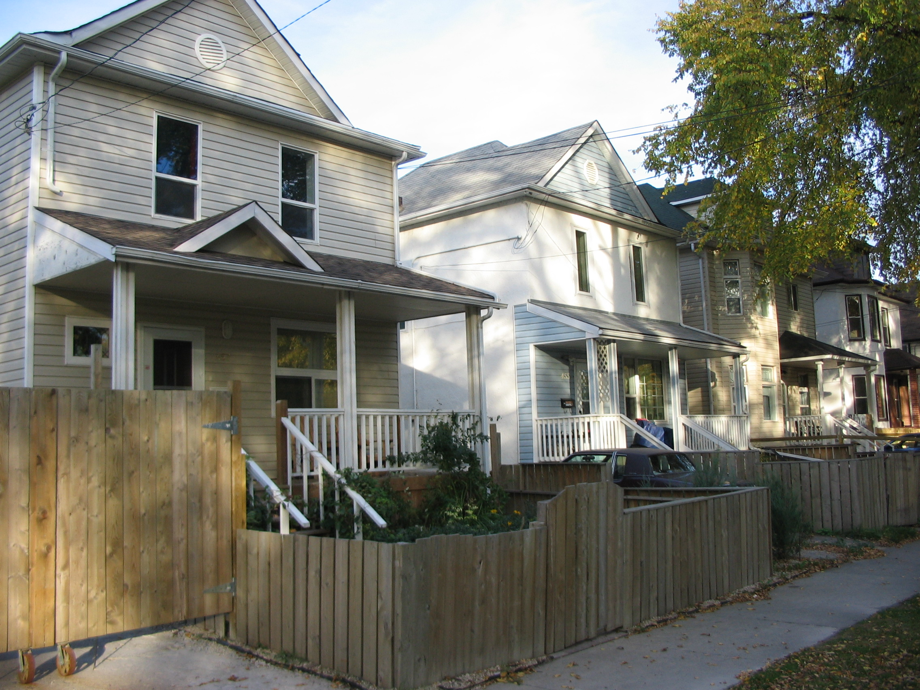

Slide 28
Participatory (Empowering) Evaluation
- Community control of
Purpose
Design
Conduct
Analysis
Use/Dissemination (knowledge mobilization)

Slide 29
Participatory (Empowering) Evaluation
- Community control of
Purpose
Design
Conduct
Analysis
Use/Dissemination (knowledge mobilization)

Slide 30
My questions
“How can North End Housing Project become more culturally appropriate”

Slide 31
Community re-write
“North End Housing Project is fixing up some old buildings on the street.
How can they help with culture”

Slide 32
Most common response
“No answer”

Slide 33
Community members’ questions
“Do you have a spirit name?”
“What kind of ceremonies have you been to?”

Slide 34
Participatory (Empowering) Evaluation
- Community control of
Purpose
Design
Conduct
Analysis
Use/Dissemination (knowledge mobilization)

Slide 35
Participatory (Empowering) Evaluation
- Community control of
Purpose
Design
Conduct
Analysis
Use/Dissemination (knowledge mobilization)

Slide 36
Participatory (Empowering) Evaluation
- Community control of
Purpose
Design
Conduct
Analysis
Use/Dissemination (knowledge mobilization)

Slide 37
Participatory (Empowering) Evaluation
- Community control of
Purpose
Design
Conduct
Analysis
Use/Dissemination (knowledge mobilization)

Slide 38
Participatory (Empowering) Evaluation
- Community control of
Purpose
Design
Conduct
Analysis
Use/Dissemination (knowledge mobilization)

Slide 39
Participatory (Empowering) Evaluation
- Community control of
Purpose
Design
Conduct
Analysis
Use/Dissemination (knowledge mobilization)

Slide 40
Participatory (Empowering) Evaluation
- Community control of
Purpose
Design
Conduct
Analysis
Use/Dissemination (knowledge mobilization)

Slide 41
