Slide 1
Notes:
Handouts:
Primer worksheets 1, 2, 3
Sunshine House example
Plain language
KT primer – link to online and 8 copies (one per group)

Slide 2
Reporting and Using Evaluation Findings
Notes:
Michael Scriven has said:
“We have very good methods for gathering social science knowledge but considerably less good advice about how to put it to use. What we most need to study is not how to do social science but how to use it.”
We often hear complaints about reports just sitting collecting dust on a shelf – with little if any consideration about whether the report, in its typical format, has any meaning or relevance to the people who are supposed to somehow take the boring, static words and charts off the page and turn them into dynamic, innovative and exciting programs! Yet we continue to act as though the problem lies with the end user not the report itself.

Slide 3
Notes:
A short walk over to Dafoe library provides the best (or perhaps the worst) example of long technical and yes, boring (I know this because I wrote one) reports sitting on shelves. My brother in law left a five dollar bill in the bound copy of his thesis that sits at Dafoe just to see if 10 years from now anybody will have found it. I suspect, 5 years in, it is still there.
Todays presentation is about thinking about reporting in a different way. Sometimes, most times, there will be a need to prepare a standard, technical report. But perhaps, if we start to think about reporting, not as an end product in itself, but as part of the overall evaluation process - from planning to implementation to use – our overall impact will be greater. The goal is to engage stakeholders in the evaluation findings so that they can understand, use and act on what they learned.
In the “research” world we call this:
Knowledge translation - KT is about communicating results in a meaningful way so that they can be used and it happens before, during and after the evaluation.
Let’s explore an example…

Slide 4
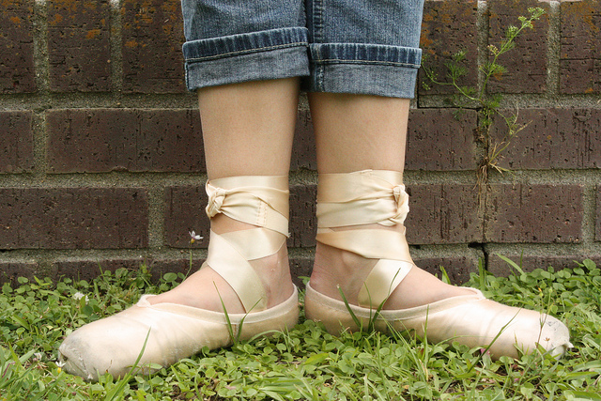
The Tragedy of First Position
Notes:
In evaluation good KT involves providing clear, relevant and useful information that makes sense to the people who need to use that information. The way we know we have done this is you give me information in a way that I can put it into action in my own context. Not by doing exactly as I was shown, but by taking what I’ve been given and turning that into something that makes sense to me.
Traditionally, evaluators deliver a report and leave folks to figure out for themselves how this is supposed to work in practice..

Slide 5
PLAN
COMMUNICATE
ASSESS IMPACT
Notes:
How do we do good KT?
First of all, apply all the principles you have been learning about this week about empowerment evaluation, participatory planning and collaboration, good community engagement.
Also, start early, think about it often and follow through.
When you are thinking specifically about your KT strategies – follow these 3 basic steps
First step: PLAN
Decide who your audience is, what you want to accomplish, and what your key message is
Second step: COMMUNICATE
Once you have decided on your audience and objectives – think about how you will get your message across
Third step: ASSESS IMPACT
Go back and make sure people are able to use the information, if not, revise
How might these steps apply in the ballet class exercise?
Plan – know your audience?
Communicate – what strategies would be most effective in this setting and with this audience?
Assess impact – did she get it?

Slide 6
PLAN
Notes:
First – lets explore planning.
The first step in good KT planning is to consider your audience. Who are they?

Slide 7
Notes:
How do you get to know your audience?
What are the relevant characteristics of your audience when it comes to sharing knowledge?
How will you involve them in your KT process?
What are the most appropriate strategies for reaching or engaging your audience?

Slide 8
what is the objective?
Notes:
What are your KT objectives?
Do you want to:
Change or influence policy or practice
Respond to a need
Demonstrate a potential role
Obtain resources
Build a partnership
Share Sunshine House example
Your turn - answer questions on first page (green)

Slide 9
keep it simple.
Notes:
What is your KT message?
What do you have to share?
What main points do you want people to remember?
Agree on key messages as a group (project advisory team, evaluation team?) check with others to be sure.
Keep it simple, limit to key points
Do these key points meet your objectives?
Share Sunshine House example
Your turn - answer questions on first page (green)

Slide 10
COMMUNICATE
C is for contrafibularity
Notes:
Choose the right format and style
What are the most appropriate ways to present information to your audience
Use plain language
Be creative
Be succinct
Show video – C is for contrafibularity
Share examples – traditional and innovative

Slide 11
Link to Garden Hill poultry video
Notes:
Digital media –
Chicken project

Slide 12
Wab kinew rapping
First Nations Regional Health Survey – Youth data
http://www.youtube.com/watch?v=zevMMAtnPXE

Slide 13
DMSCM composting challenge

Slide 14
Celebrations/feasts
- find a picture?

Slide 15
Full report vs brief – show example (handout brief – SWAT?

Slide 16
ASSESS IMPACT
Notes:
Critical step but often overlooked. Think back to the ballet example (as a metaphor for how we support evaluation use) the teacher expected that once the girls feet were in position she was good to go. What assumptions did she make? (assumed that the child had good balance; assumed that she understood what to do with her feet; assumed that she would ask if she needed help again… others).
I believe that as evaluators we have an obligation to follow through after the reporting is done to make sure our work was useful and if not what can we do to make it useful.
Examples:

Slide 17
Notes:
IMAGE: detective novel “The case of the vanishing evaluator”
As evaluators we need to check back with our partners to ensure that:
The information is relevant and presented in a way that can be integrated into practice
They have the capacity and resources required to implement
We maintain connections required to enable them to come back and ask questions – engage people
Meta-evaluation = evaluation of the evaluation
How would you do this? How would you define success in terms of positive evaluation outcomes?

Slide 18
Follow through
Engage people
Support use
Notes:
Revise the product (multiple editions…) example of something that is dated / irrelevant
Does the product need to change over time?
Complete step 3

